Slide 1
PRESENTED BY : Rethanya C
REGISTER NO : 730321243021
DEPARTMENT : Artificial Intelligence and data Science
3/21/2024 Annual Review

Slide 2
PROJECT TITLE
VIDEO COLORIZER USING AI-DEEP LEARNING TECHNIQUE
3/21/2024 Annual Review

Slide 3


AGENDA
Problem Statement
Project Overview
Who are the end users?
Your solution and its value proposition
The wow in your solution
Modelling
Results

Slide 4

PROBLEM STATEMENT
The task is to develop an AI-based video colorization system that can automatically add color to grayscale videos. Traditional methods for colorizing videos are often time-consuming and labor-intensive, requiring manual intervention. This project aims to leverage deep learning techniques to create an efficient and accurate solution for automatically colorizing grayscale videos.

Slide 5

PROJECT OVERVIEW
This project addresses the limitations of traditional manual colorization methods, which are time-consuming and require extensive human effort and the project targets applications in fields such as film restoration, historical documentation, and digital media production, providing a valuable tool for filmmakers, archivists, researchers, and enthusiasts alike. By training a deep neural network on a large dataset of color videos, the goal is to create a model capable of accurately inferring colors for each frame of a grayscale video.
.

Slide 6

WHO ARE THE END USERS?
Filmmakers and Video Editors
Archivists and Historians
Educators and Research
Digital Media enthusiastic
Software Developers and AI Enthusiasts
Content Creators and Social Media Users
Non-profit Organizations

Slide 7

YOUR SOLUTION AND ITS VALUE PROPOSITION
SOLUTION:
Collect a dataset of black and white videos paired with their color versions. Train a deep learning model, such as a convolutional neural network, on this dataset. Evaluate the model's performance using metrics like PSNR and SSIM. Fine-tune the model if necessary to improve results. Integrate the trained model into an application for video colorization.
VALUE PROPOSITION:
Our AI-powered video colorizer utilizes cutting-edge deep learning technology to seamlessly convert black and white videos into vibrant, true-to-life color representations. By harnessing the power of advanced neural networks, we offer unparalleled accuracy and efficiency in restoring the visual richness of grayscale footage. Transform your nostalgic memories and vintage films into vivid, captivating experiences with our intuitive and user-friendly colorization solution.

Slide 8

THE WOW IN YOUR SOLUTION
The "wow factor" of your video colorizer project lies in its ability to breathe new life into old or monochrome footage, instantly transforming it into vibrant, colorful content. This technology enables users to experience their favorite memories, historical footage, or artistic creations in a fresh and engaging way, evoking a sense of nostalgia and wonder. With just a few clicks, users can witness the magic of AI-powered colorization, unlocking a world of visual possibilities and enhancing the storytelling impact of their videos.
8

Slide 9
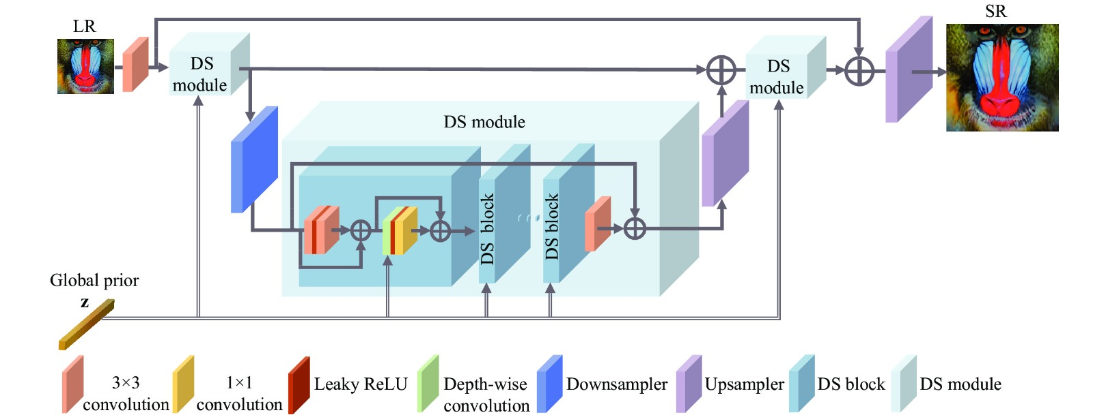
MODELLING
9

Slide 10
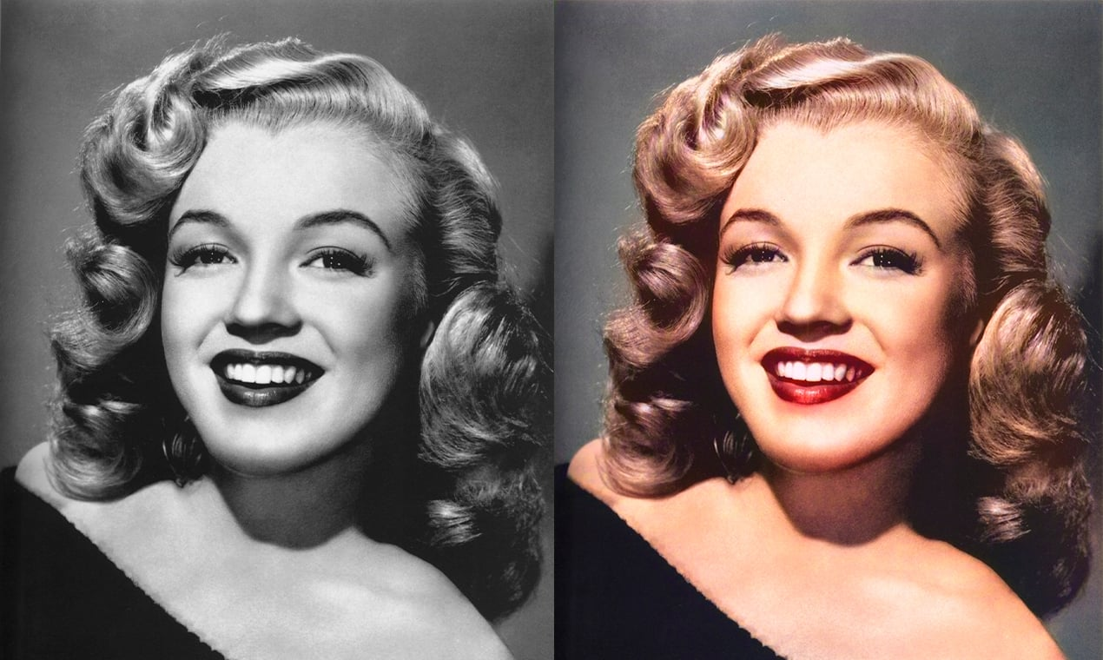
RESULTS
.
The result of your video colorizer project would be a software application or tool capable of taking input in the form of black and white or grayscale videos and producing output videos where the grayscale frames have been accurately colorized. Users would experience visually appealing and lifelike colorizations of their videos, preserving or enhancing the original content's visual richness and emotional impact.
Demo Link:https://github.com/Rethanyachandran/naan-mudhalvan.git
10

